Slide 1

Design Sprint Foundations
Project 2: The Storyboard

Slide 2

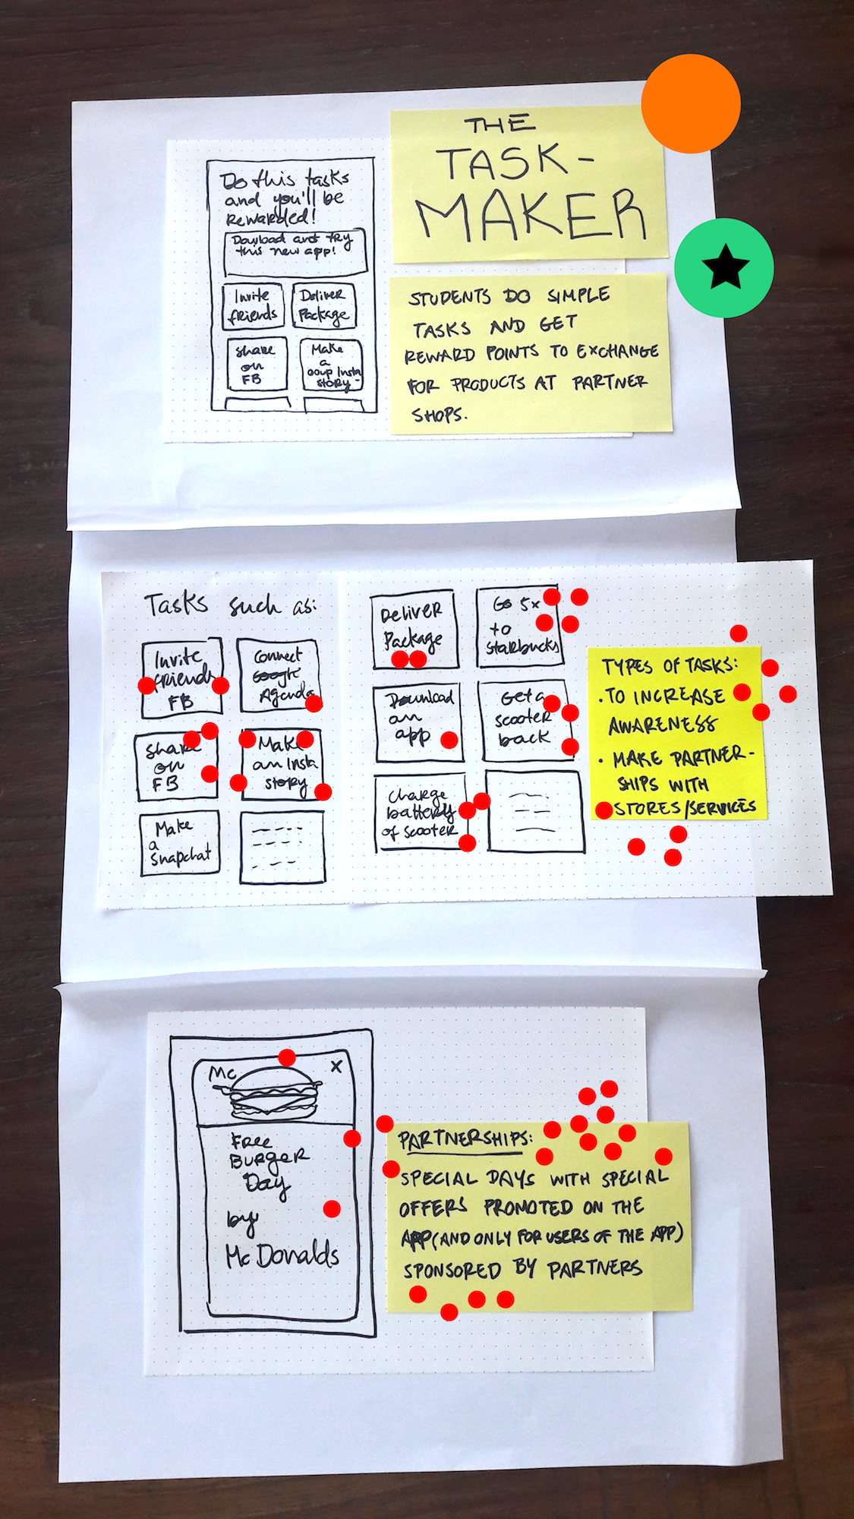
DECIDER’S SELECTED
CONCEPT

Slide 3
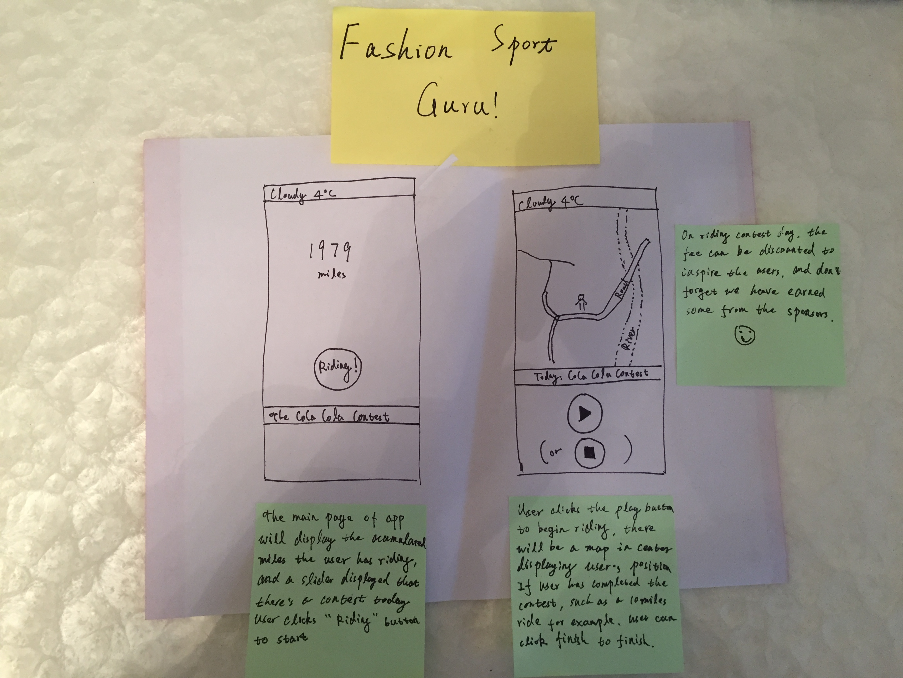
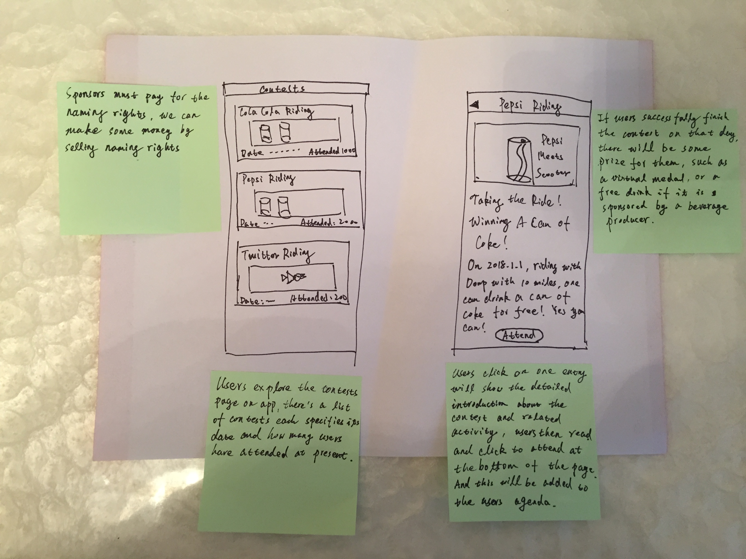
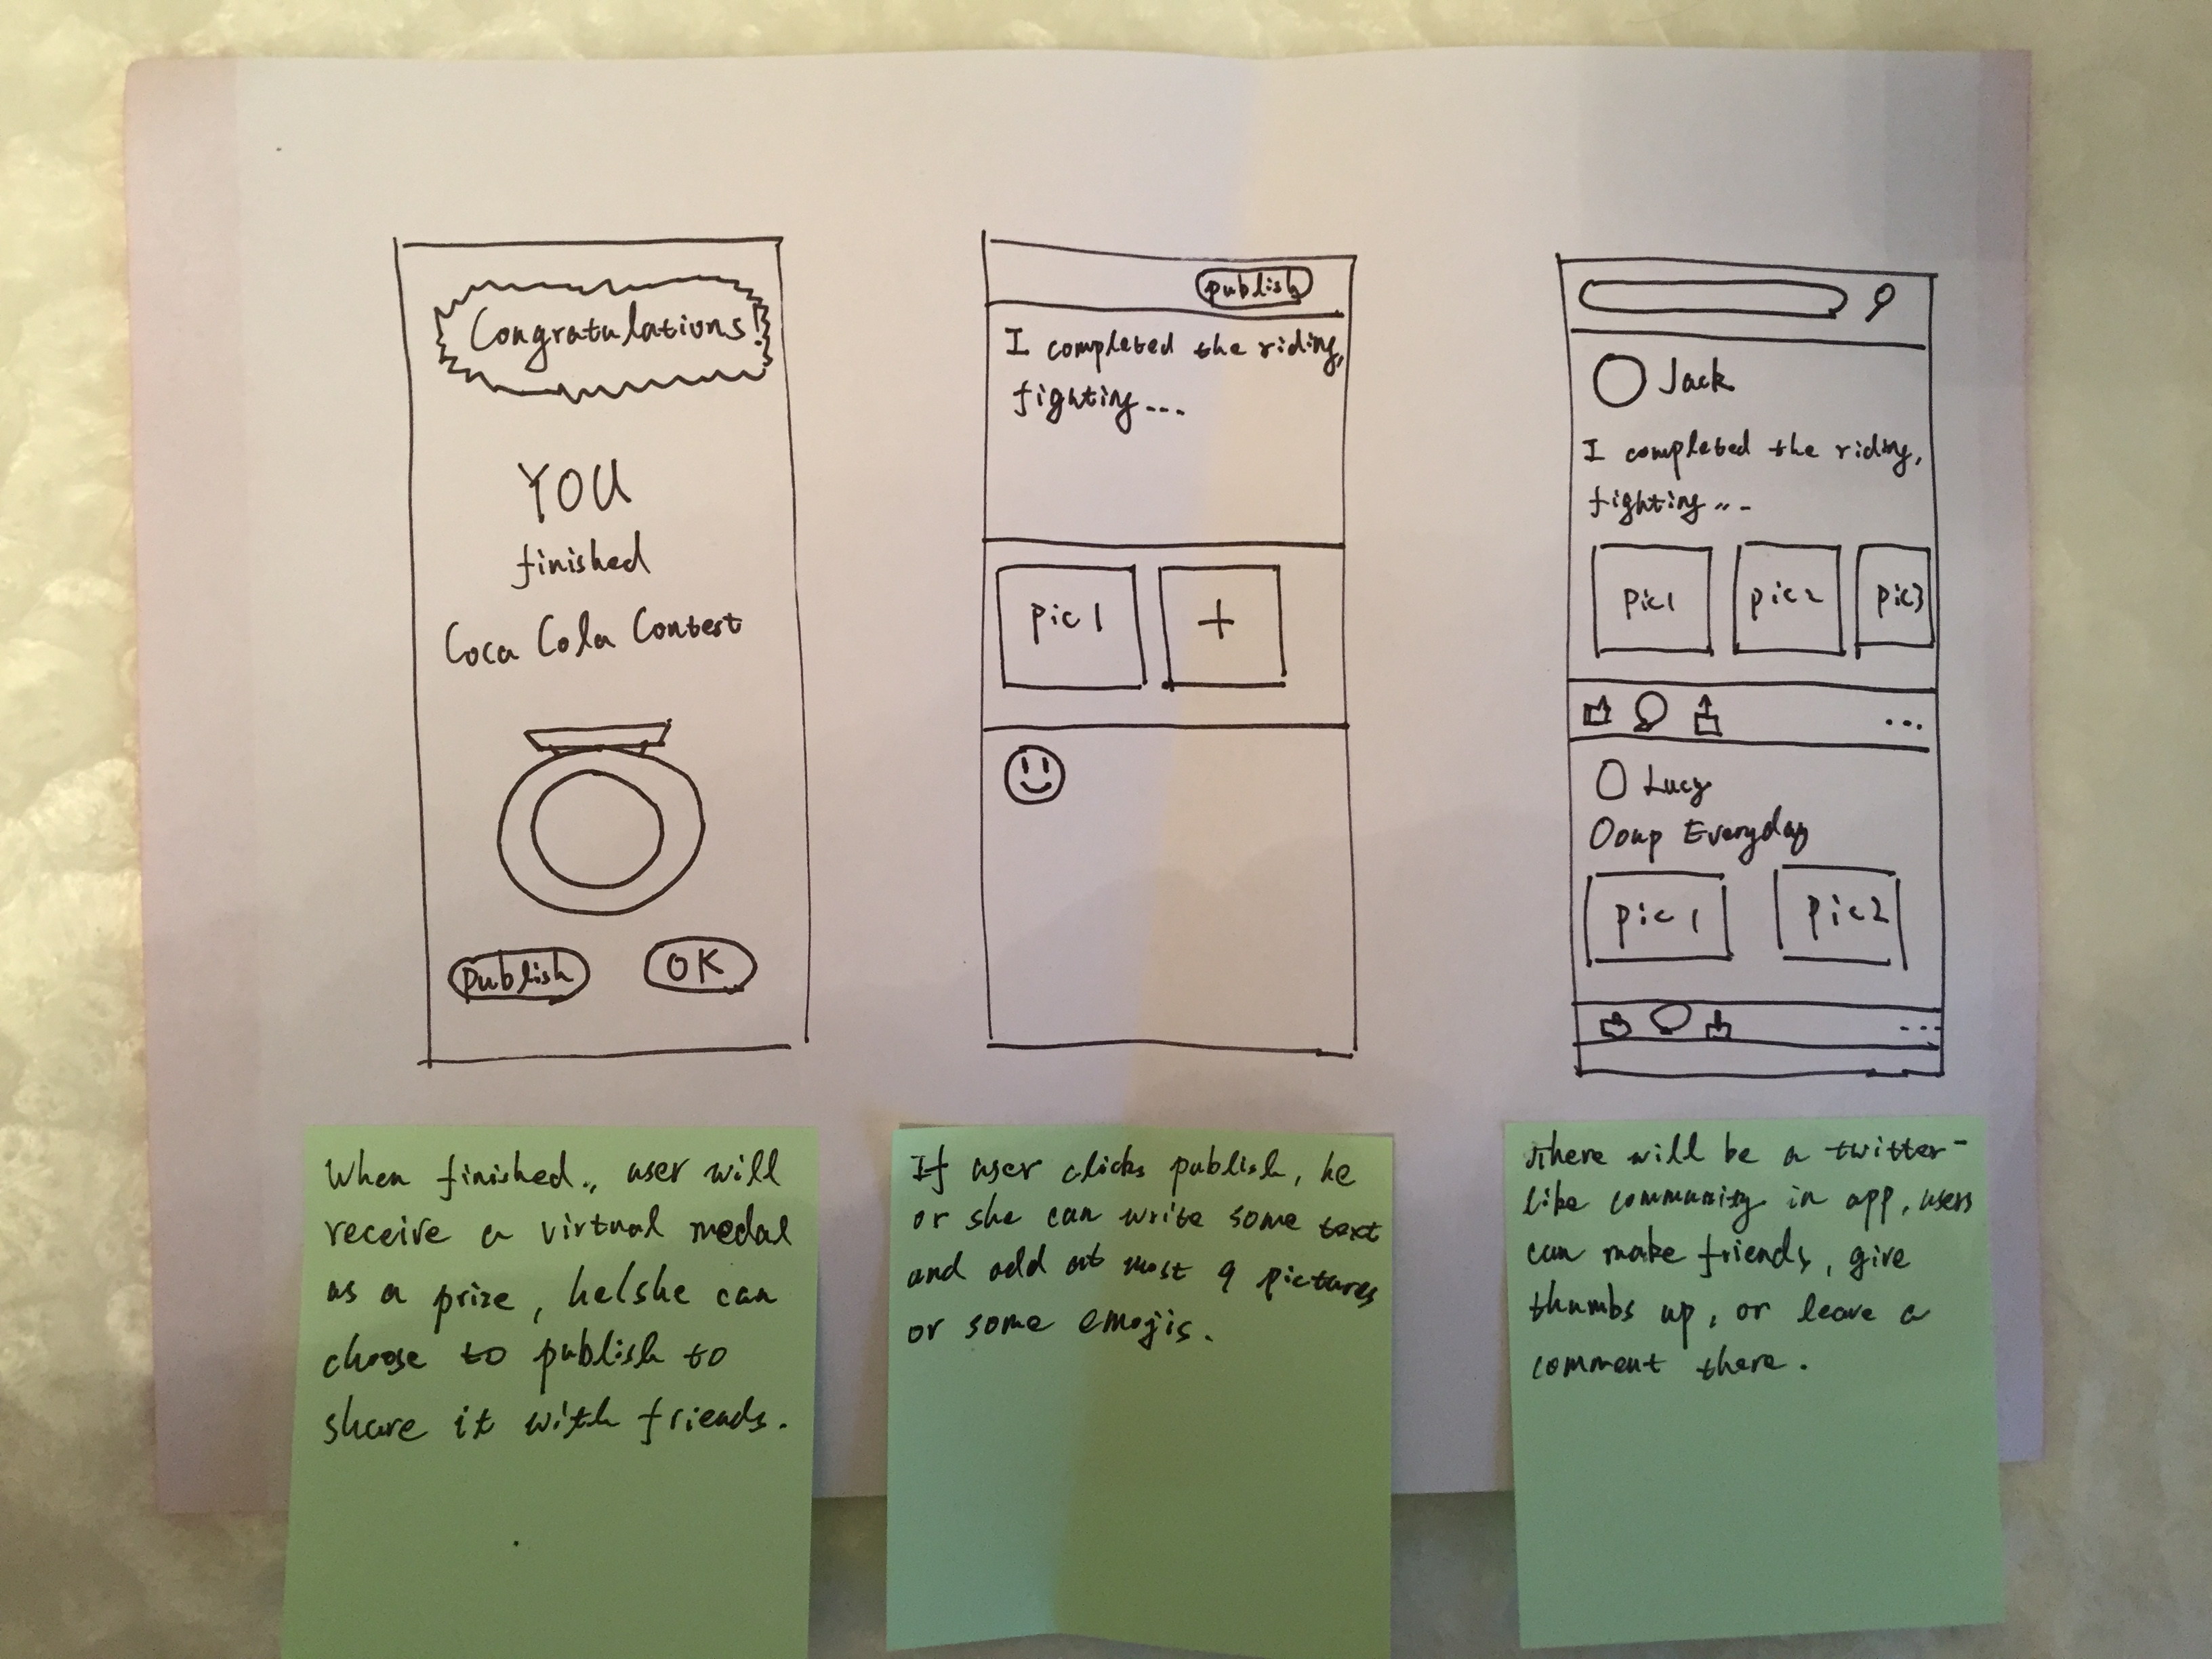
MINE SELECTED
CONCEPT

Slide 4

YOUR USER TEST FLOW
1
People reads a twitter about Ooup.
2
Read the introduction page to get the details of contests.
3
Download, sign up upon registered.
4
5
6
Explore a list of riding contests.
Choose to attend one contest.
Completes the riding contest and earn a reward coupon.

Slide 5


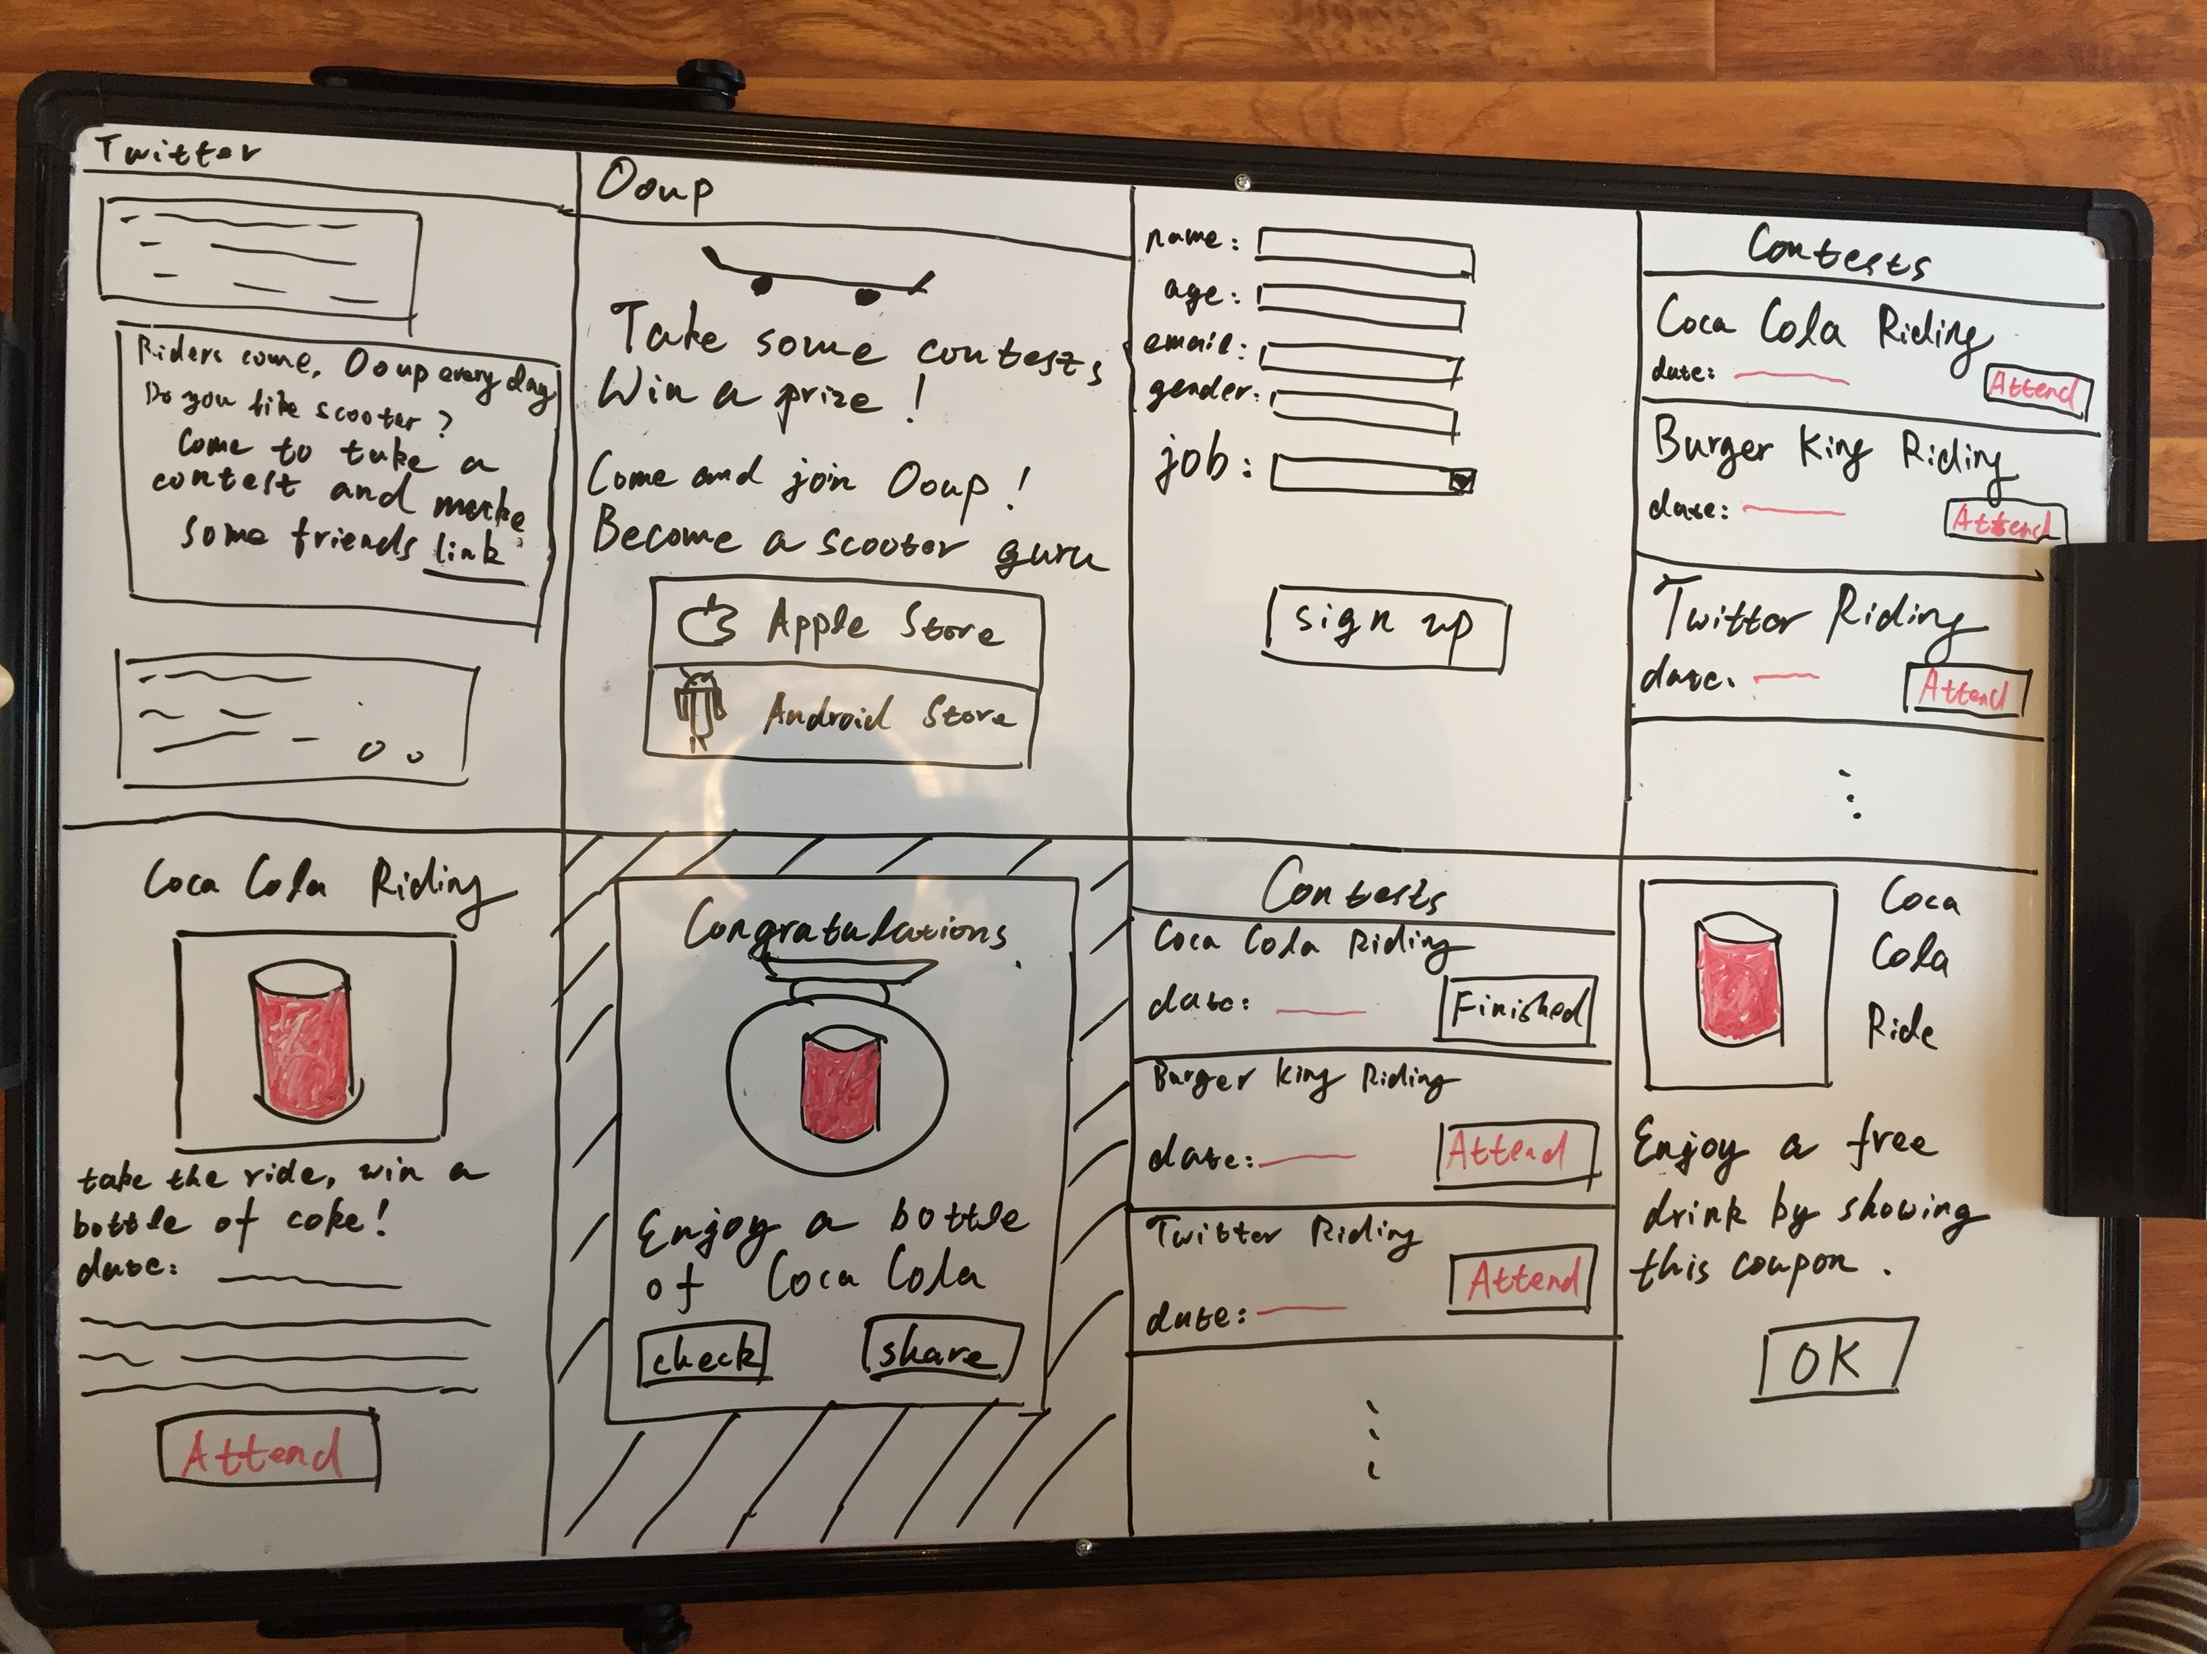
STORYBOARD: ENTIRE VIEW
insert actual image
Description goes here

Slide 6
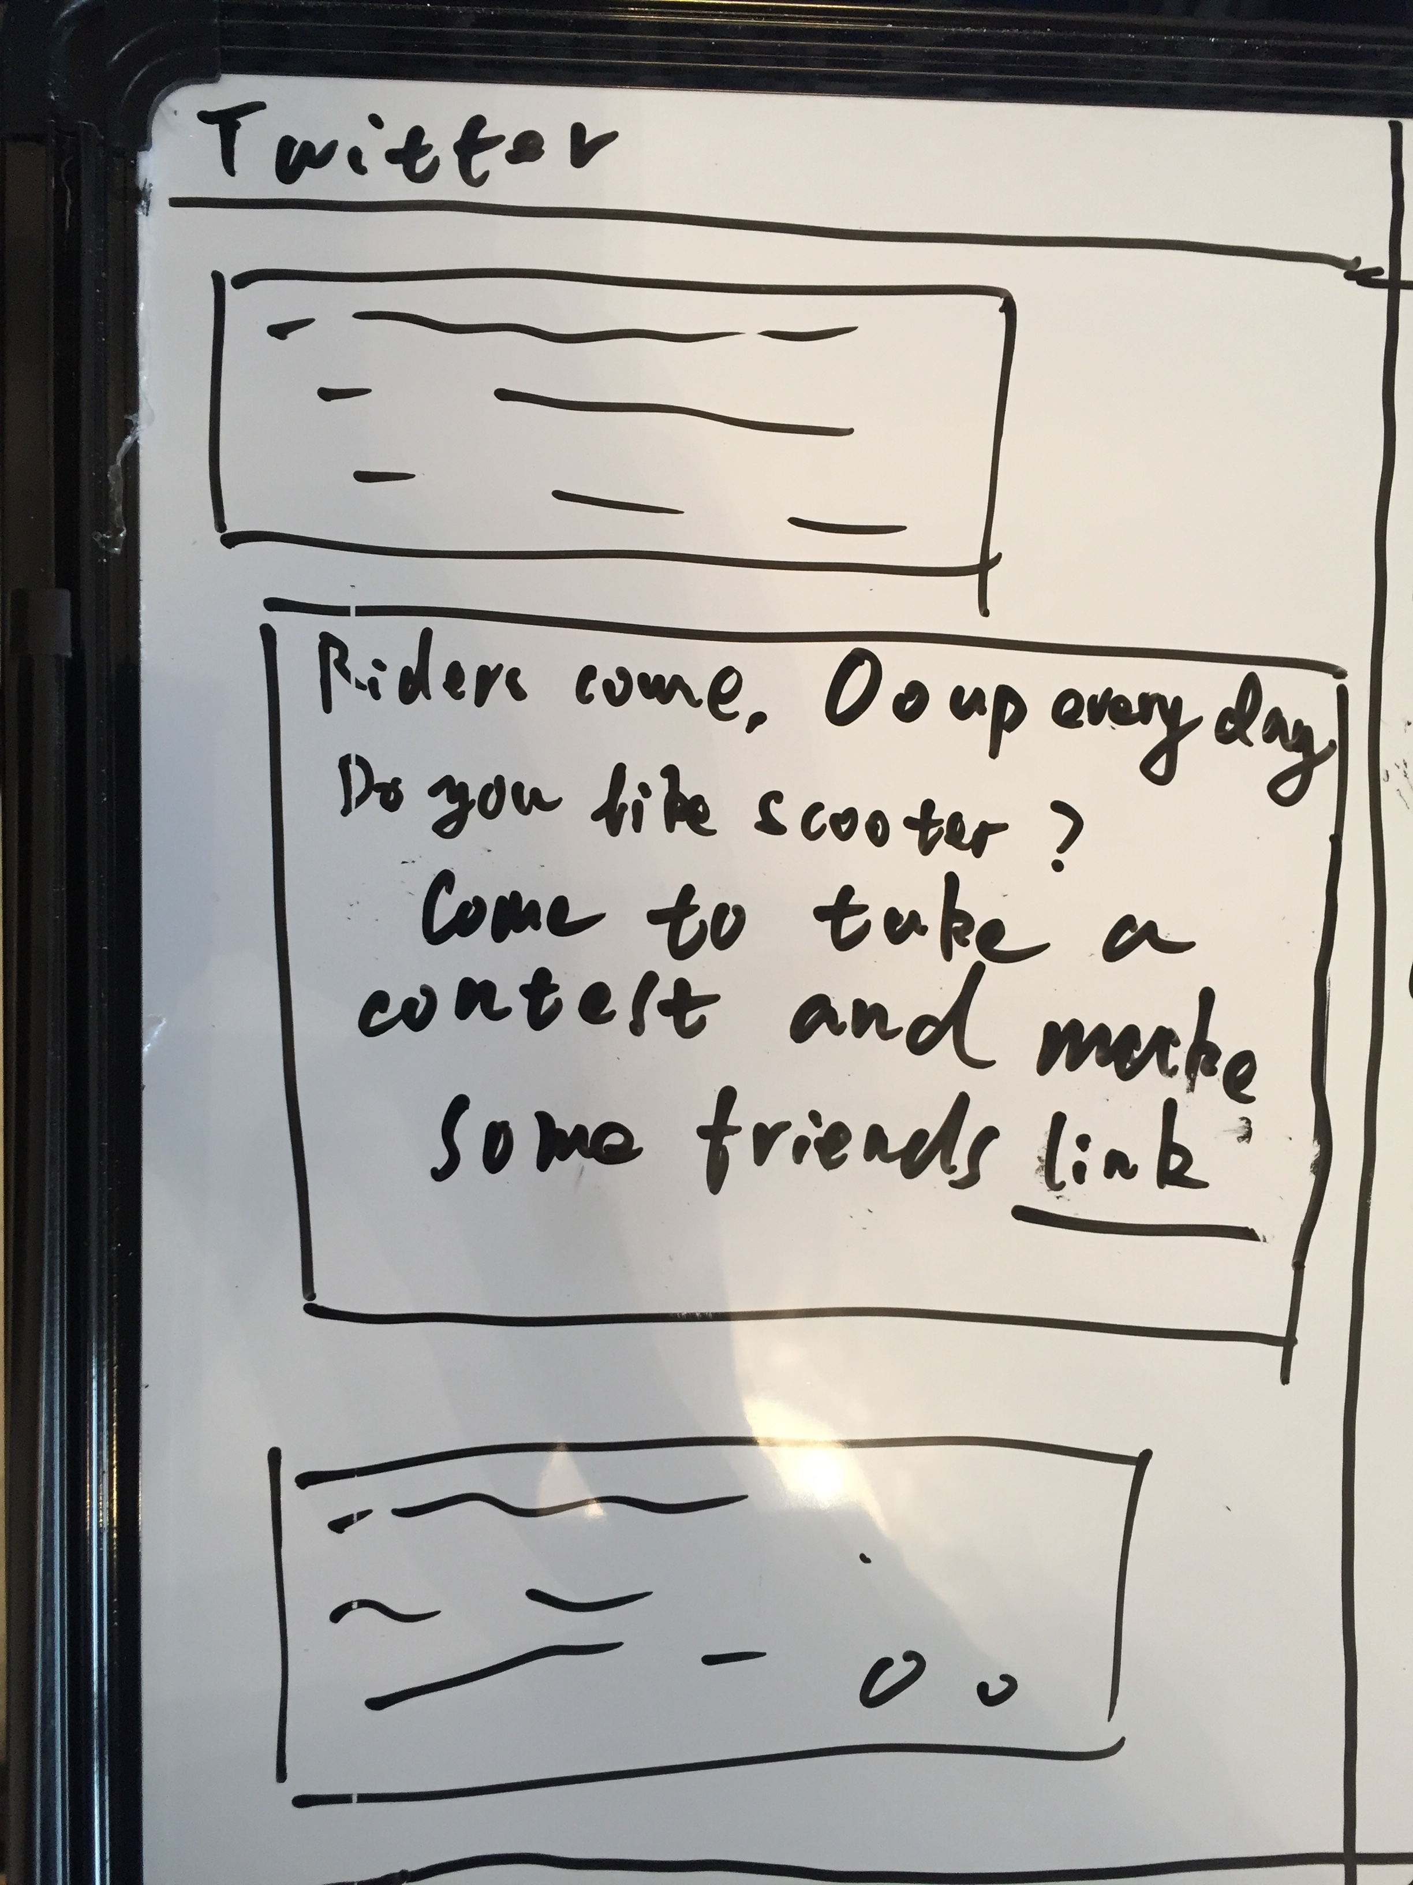
STORYBOARD: CELL 1 DETAIL
insert actual image
Description goes here

Slide 7
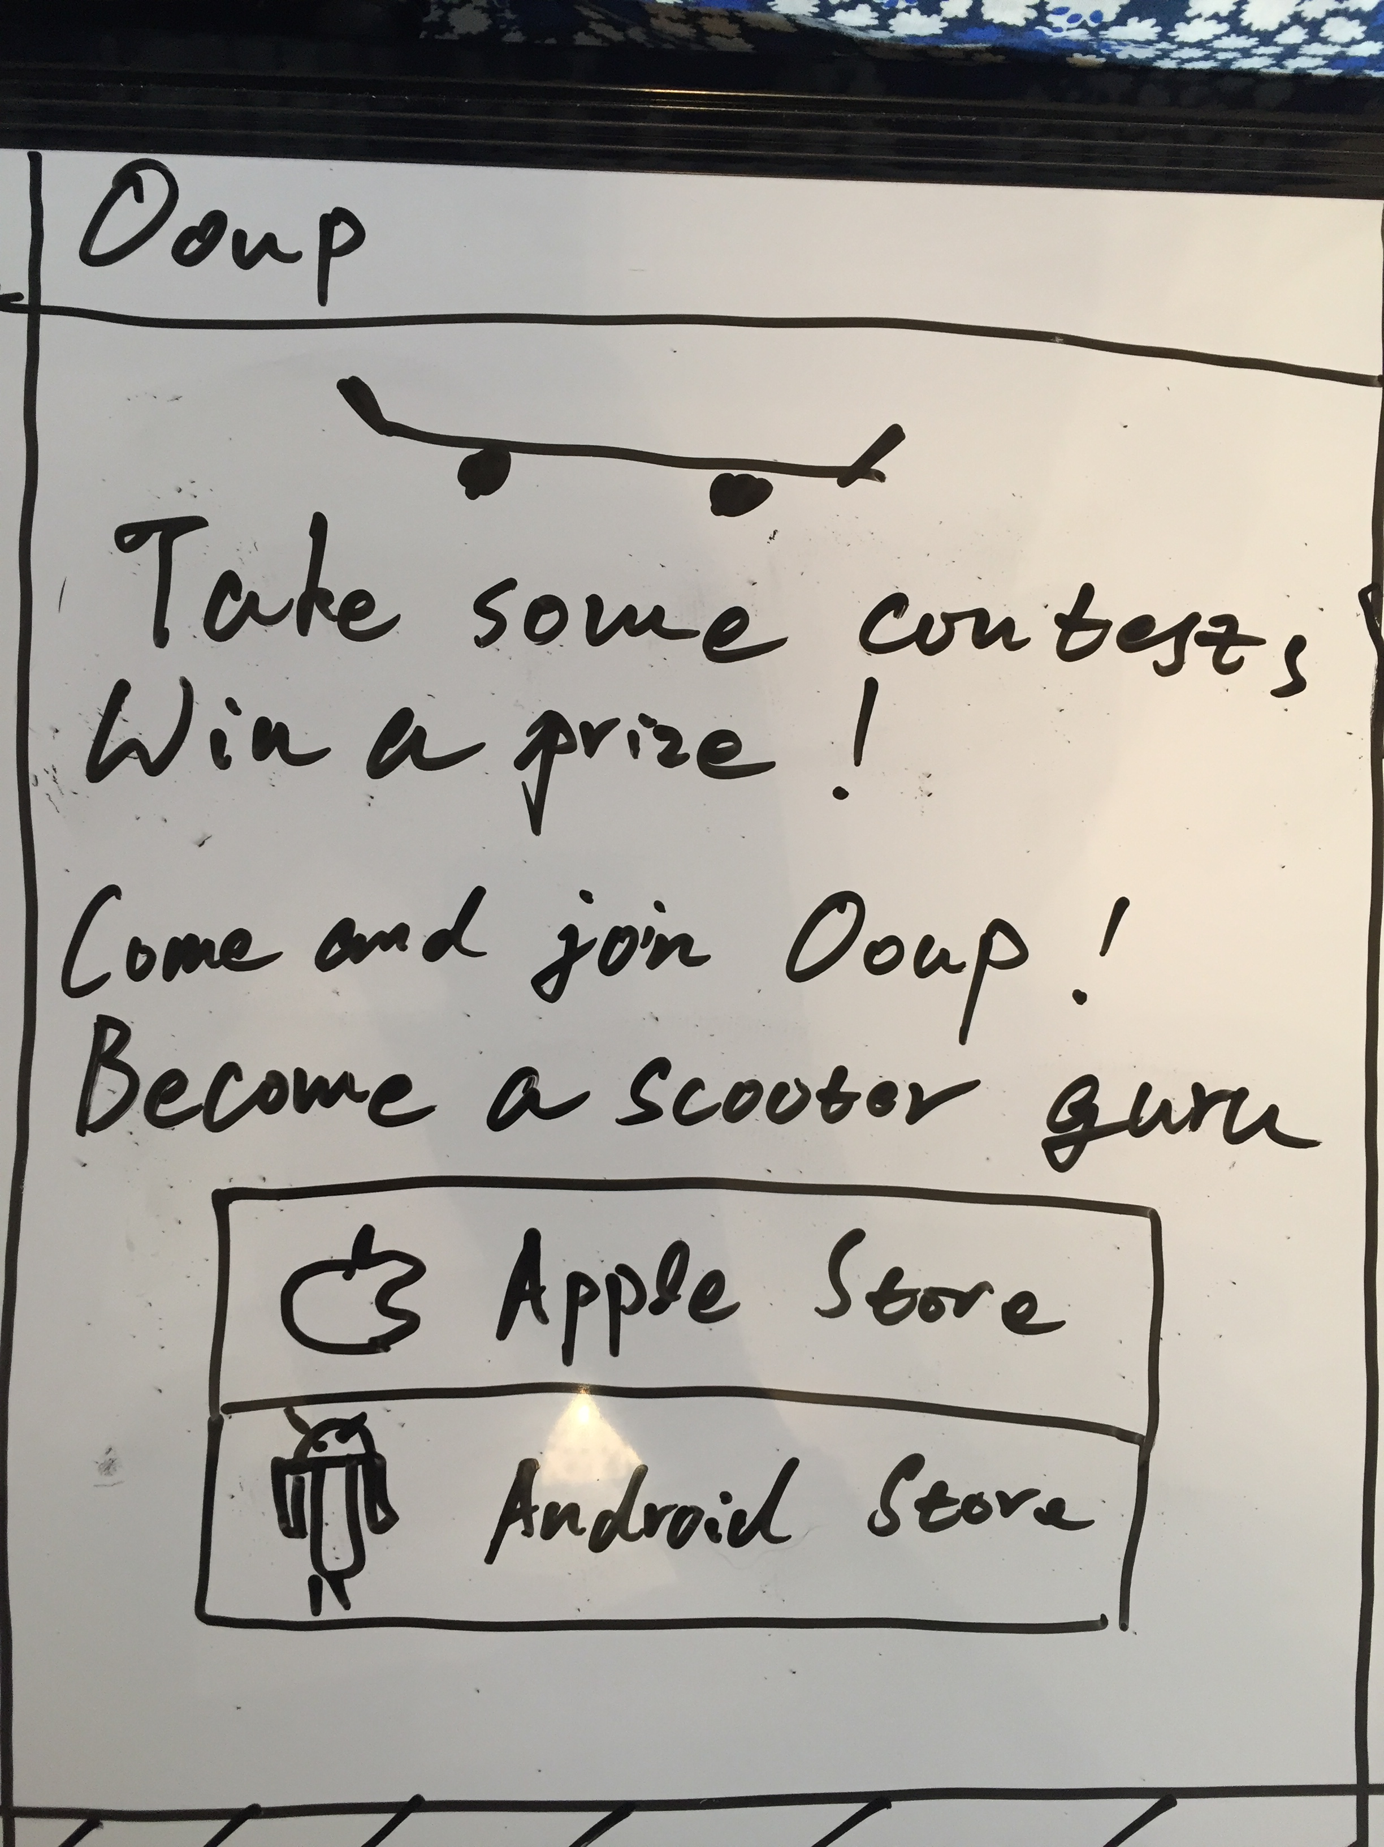
STORYBOARD: CELL 2 DETAIL
insert actual image
Description goes here

Slide 8
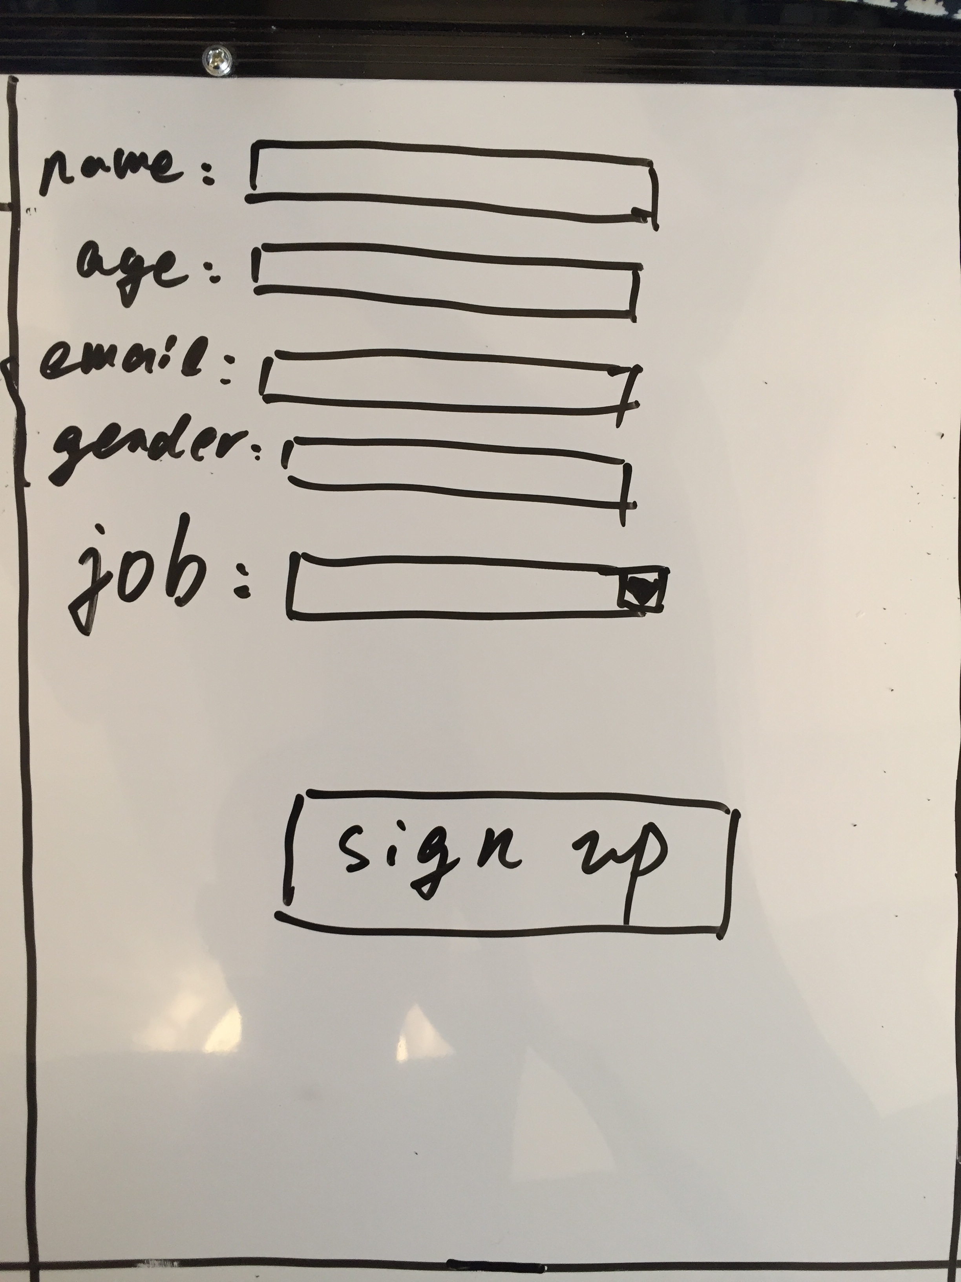
STORYBOARD: CELL 3 DETAIL
insert actual image
Description goes here

Slide 9
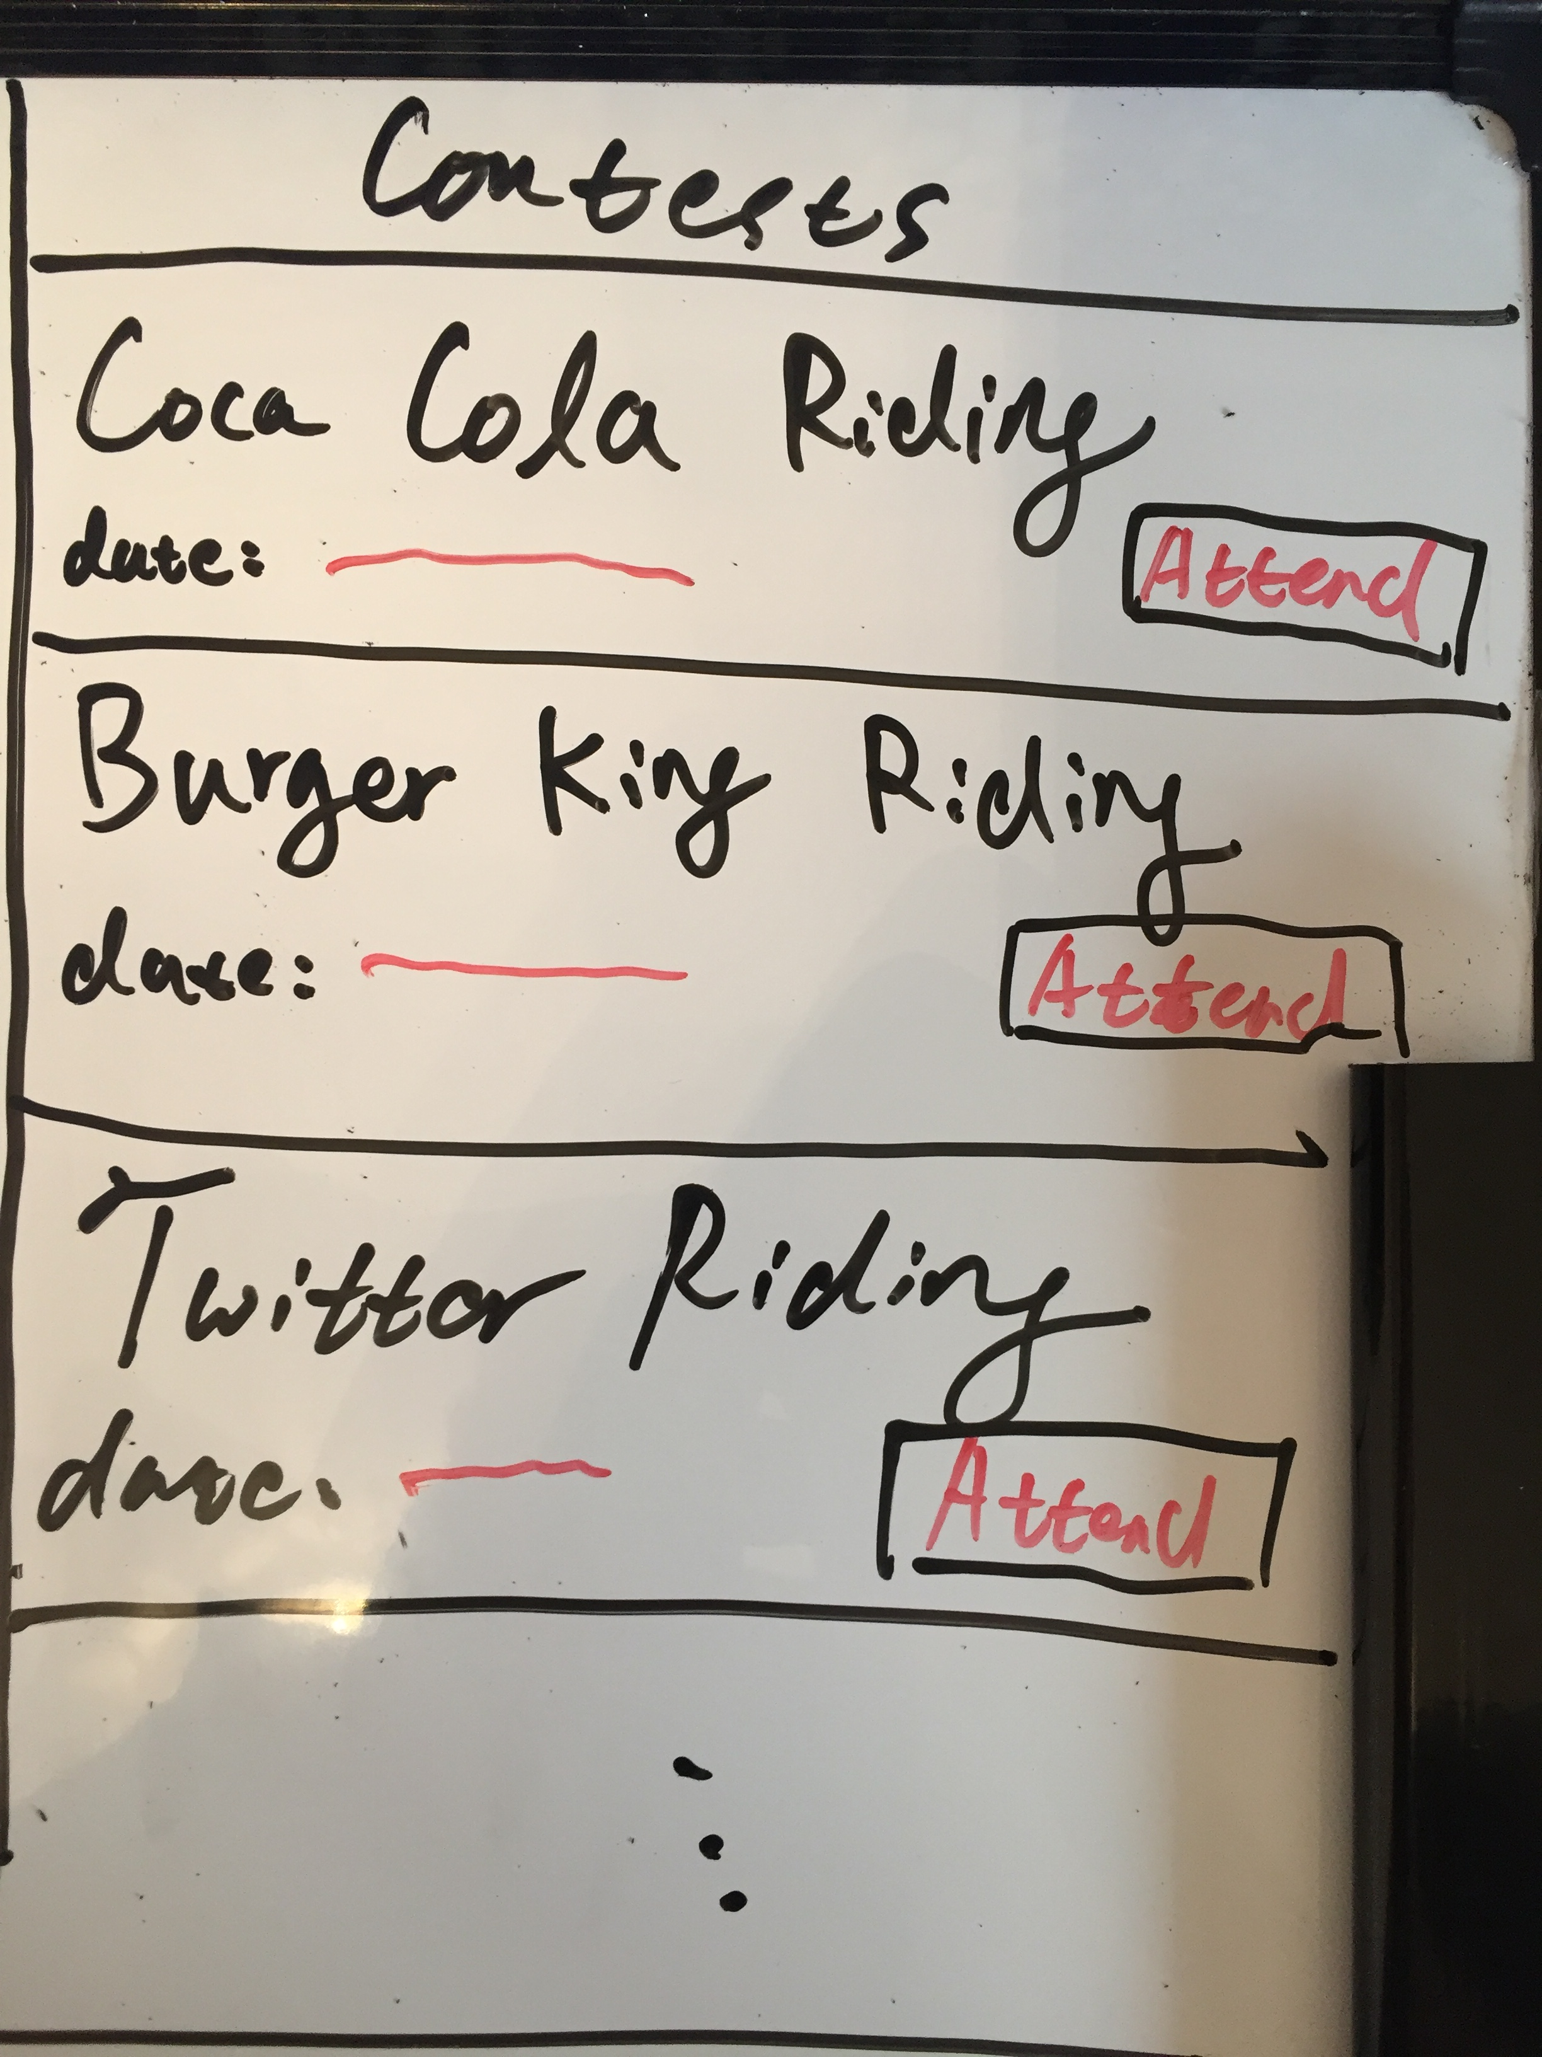
STORYBOARD: CELL 4 DETAIL
insert actual image
Description goes here

Slide 10
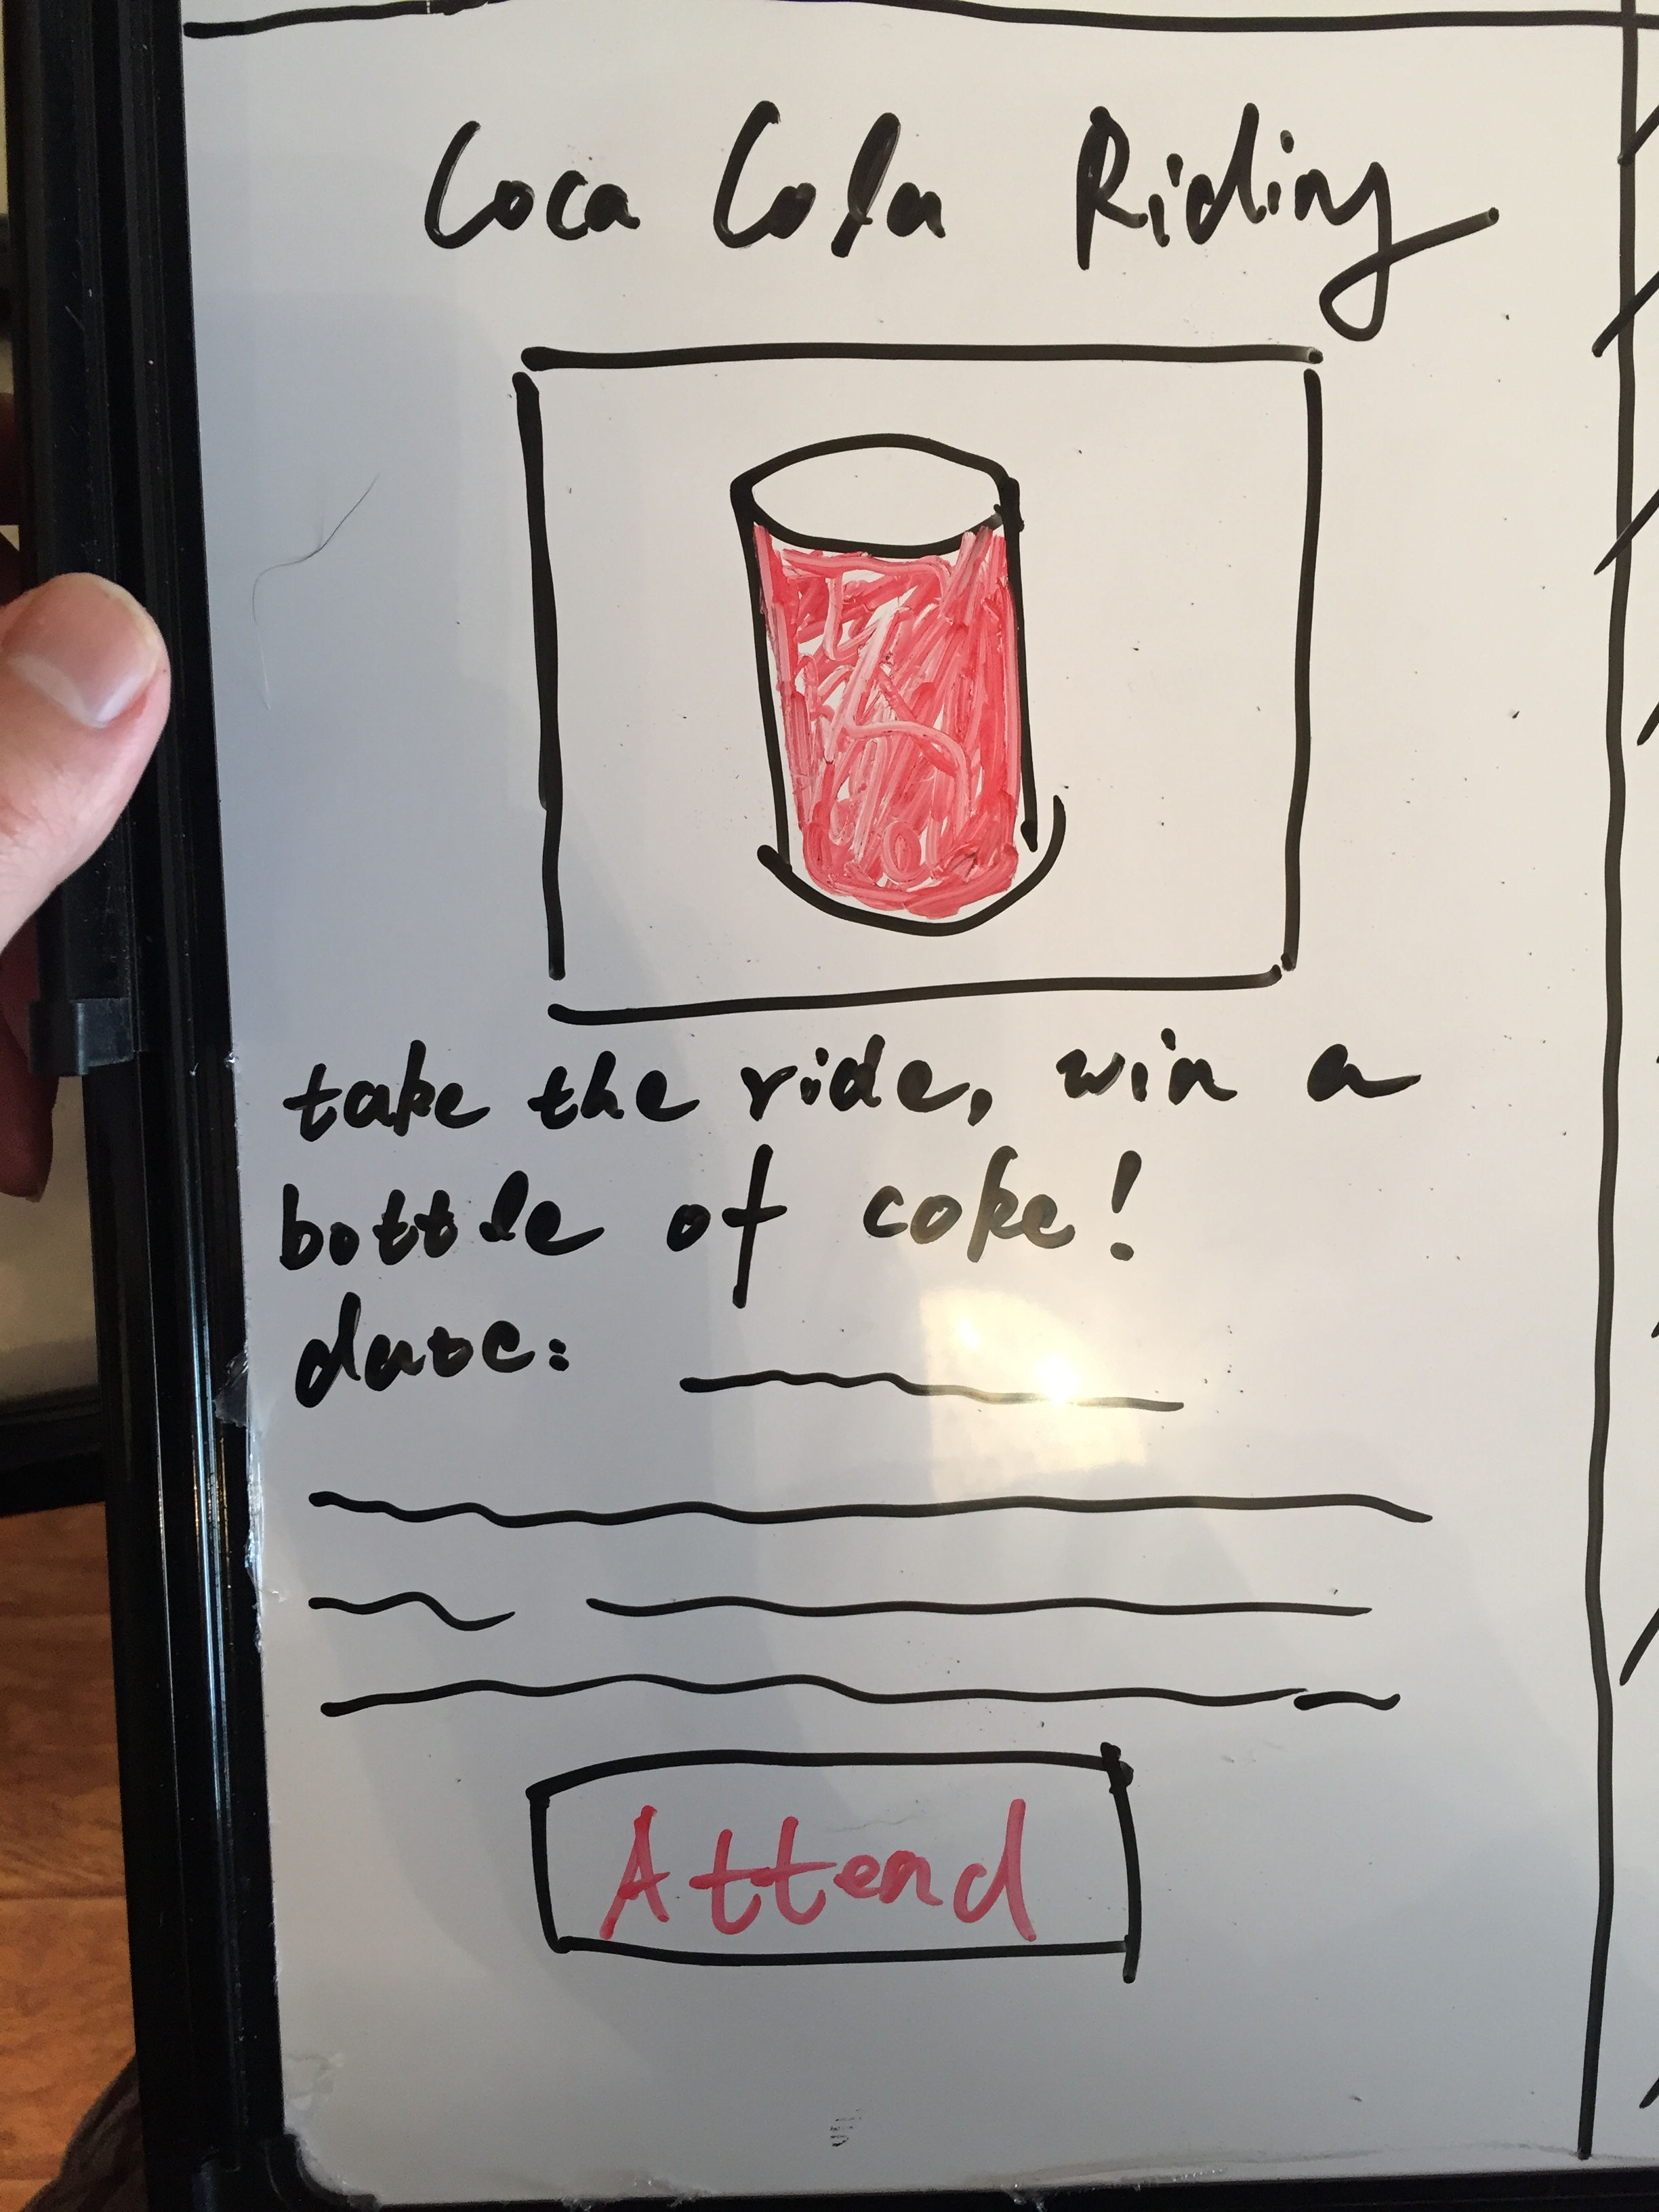
STORYBOARD: CELL 5 DETAIL
insert actual image
Description goes here

Slide 11
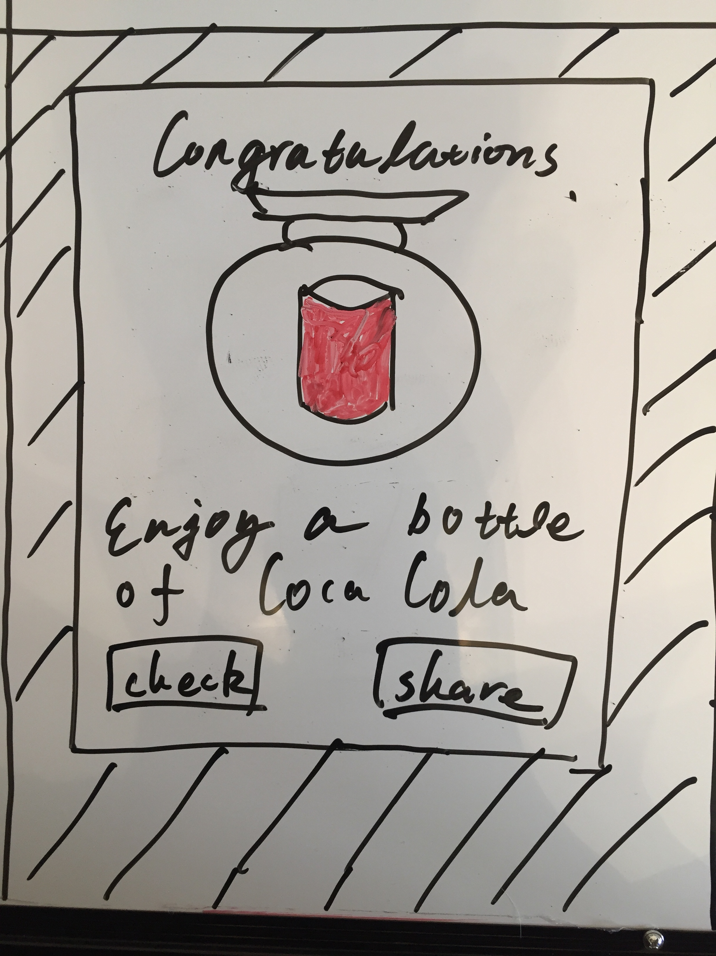
STORYBOARD: CELL 6 DETAIL
insert actual image
Description goes here

Slide 12
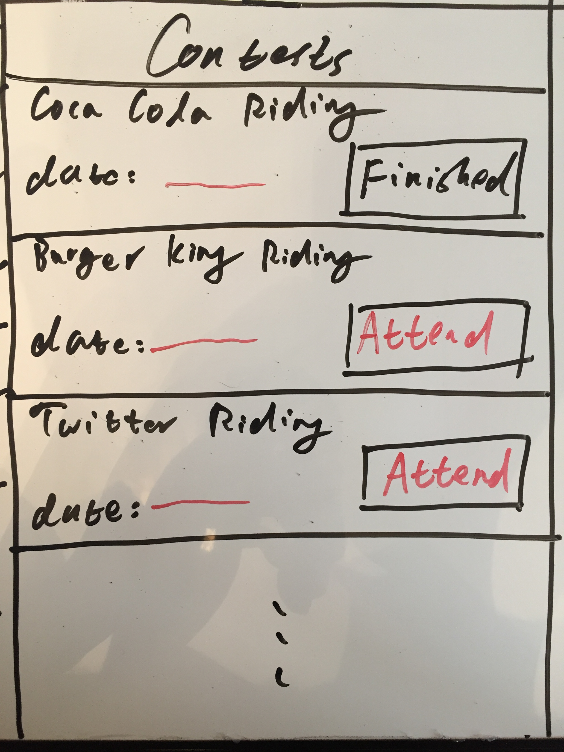
STORYBOARD: CELL 7 DETAIL
insert actual image
Description goes here

Slide 13
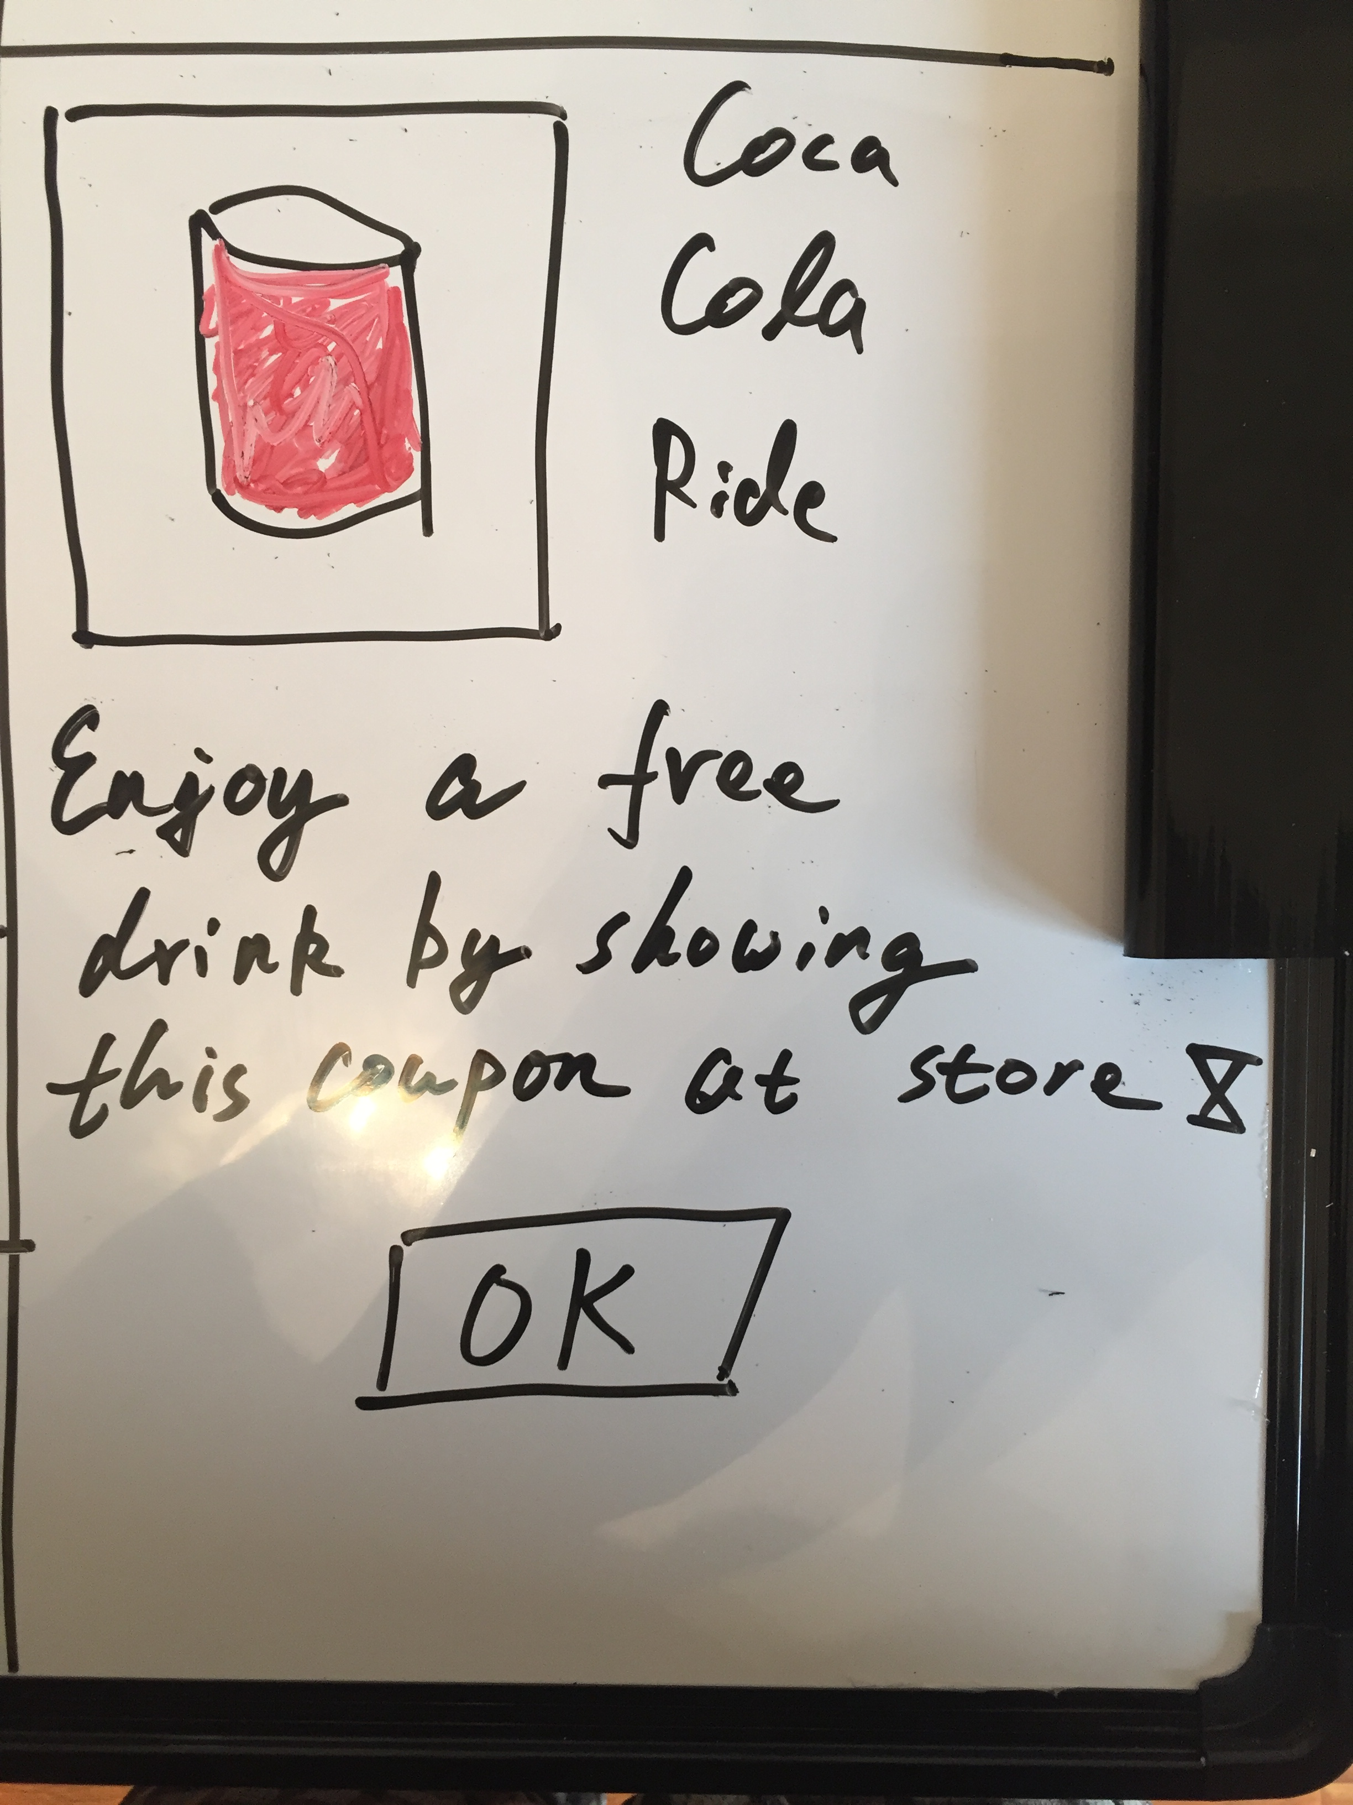
STORYBOARD: CELL 8 DETAIL (duplicate if you need more)
insert actual image
Description goes here

